Slide 1
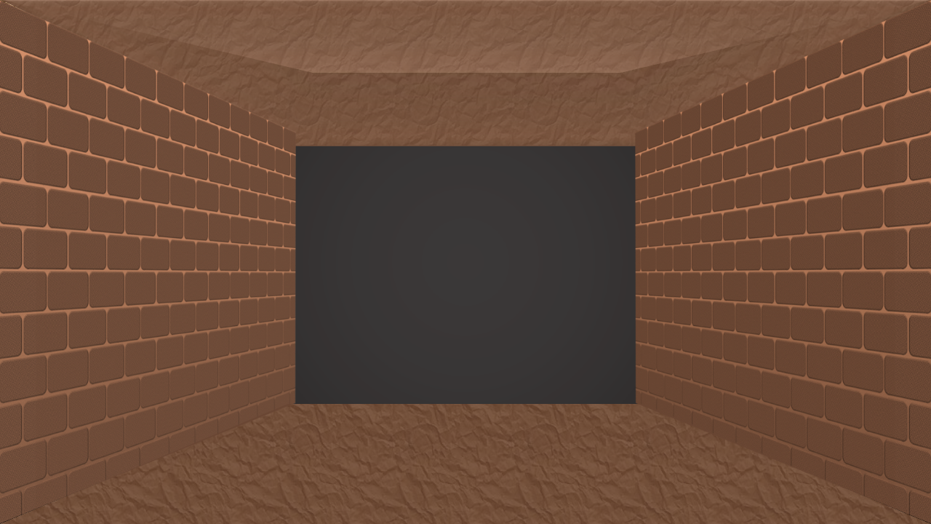

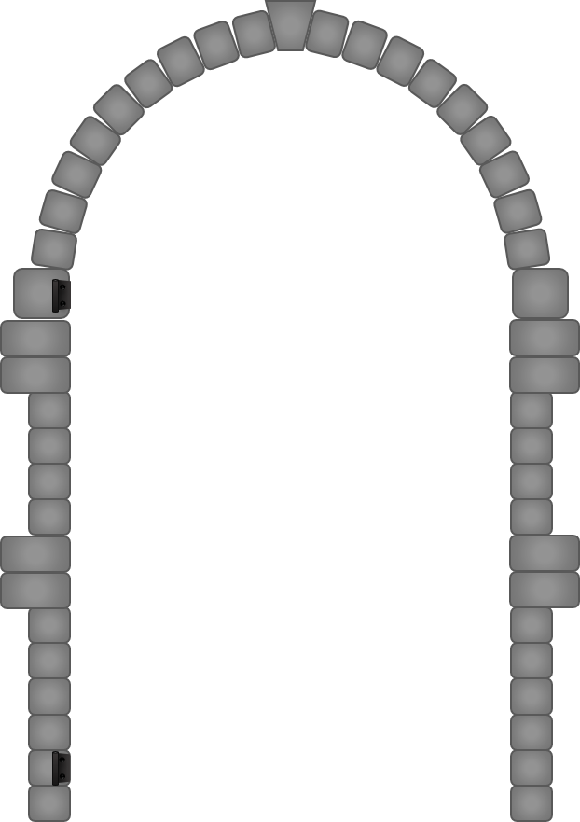
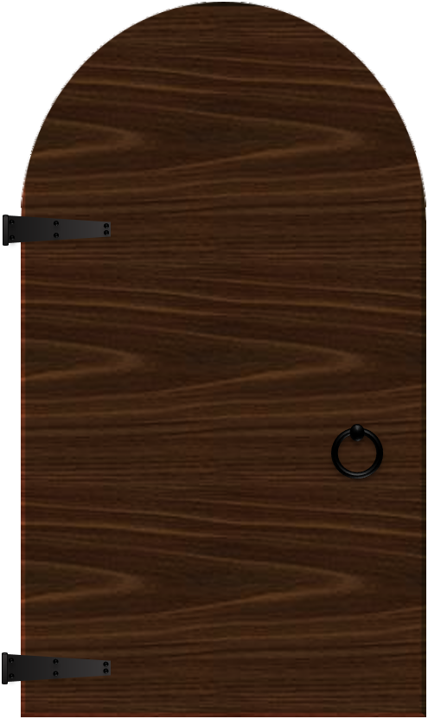

Are you ready to enter
THE DUNGEON?
tekhnologic

Slide 2
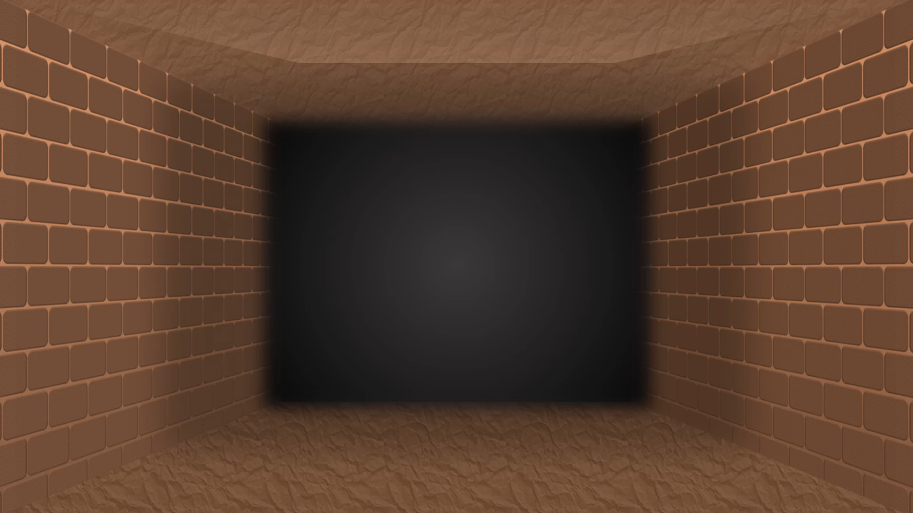

Slide 3


Slide 23

LEVEL CLEARED!!!

